Slide 1
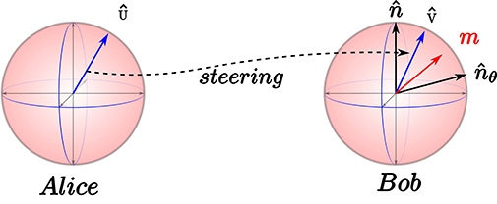
Measurement-induced Quantum Steering
From Internet
Yiyang Jiang, Tsinghua University

Slide 2
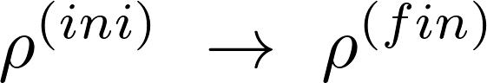
Goal:
Traditional Methods & Their Drawbacks:
1. Projective Measurement (Probablistic)
2. Thermal Contact (Low T Needed)
3. Perturbation (Precise Interval Control Needed)
Roy, Sthitadhi, et al. Physical Review Research 2.3 (2020): 033347.

Slide 3
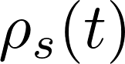
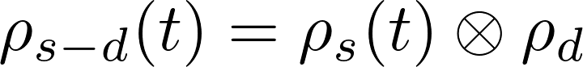
Procedure of Measurement-induced Quantum Steering
s: system
d: detector
Trace out detector (Decouple)
Couple to detector
Unitary evolution
Roy, Sthitadhi, et al. Physical Review Research 2.3 (2020): 033347.

Slide 4
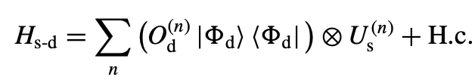
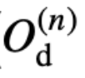
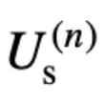
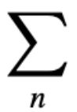
Selection of the Coupling Hamiltonian
acts on the detector Hilbert space, flipping the detector qubit
acts on the system Hilbert space, steering the system towards the target state
sums over states orthogonal to the target state
Roy, Sthitadhi, et al. Physical Review Research 2.3 (2020): 033347.

Slide 5
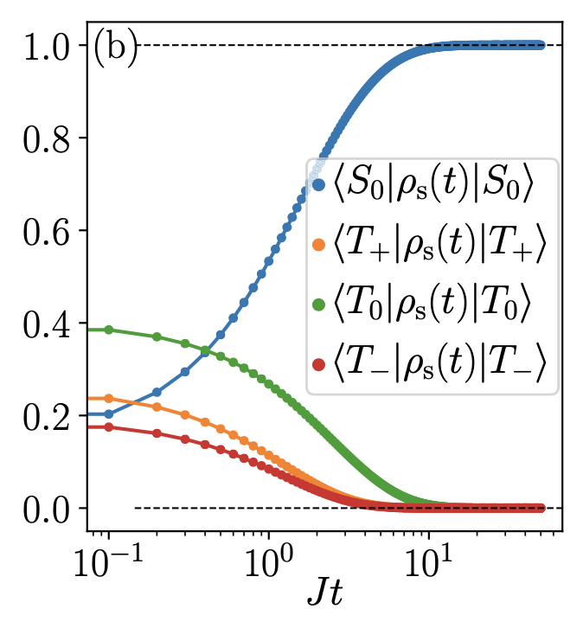
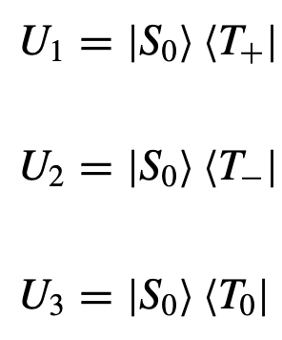
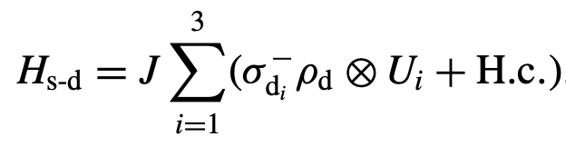
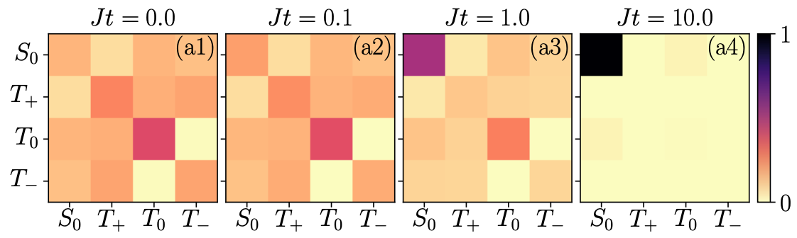
Examples of (Passive) Quantum Steering
e.g.1 Few-Body (Spin-1/2 Pair towards Singlet State)
Roy, Sthitadhi, et al. Physical Review Research 2.3 (2020): 033347.

Slide 6
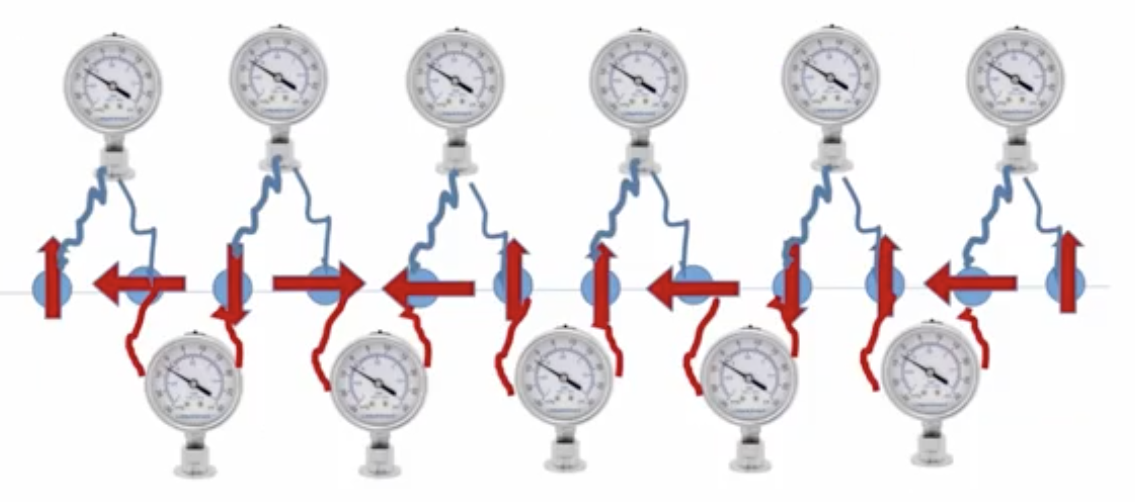
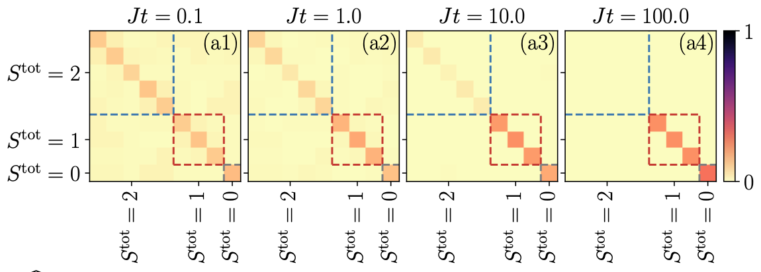
Examples of (Passive) Quantum Steering
e.g.2 Many-Body (Spin-1 Chain Towards AKLT State)
Dimension Explosion of Many-body Hilbert Space
Locality of Detector
Competition between Detectors
Detector Sequence
Roy, Sthitadhi, et al. Physical Review Research 2.3 (2020): 033347.

Slide 7
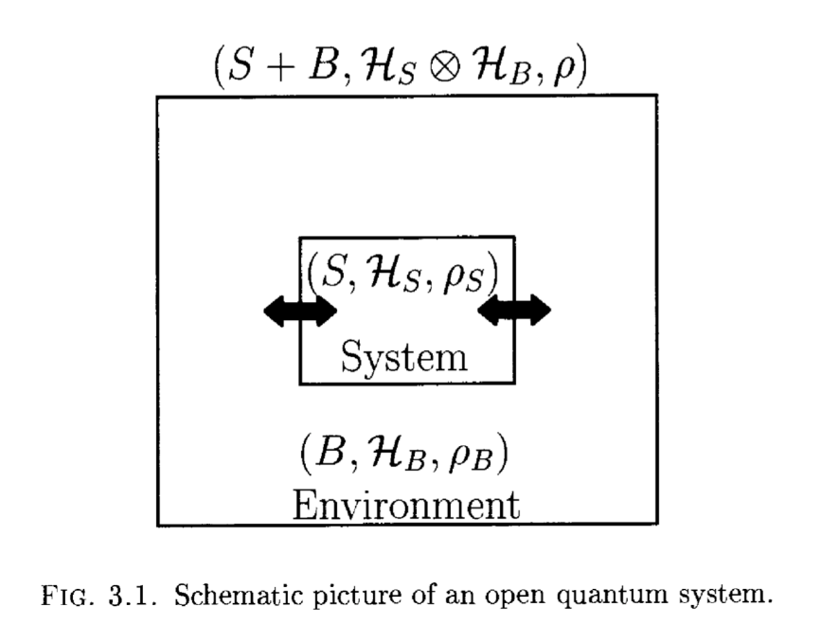
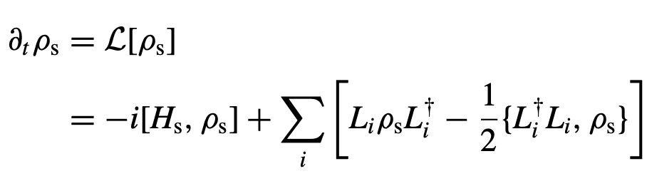
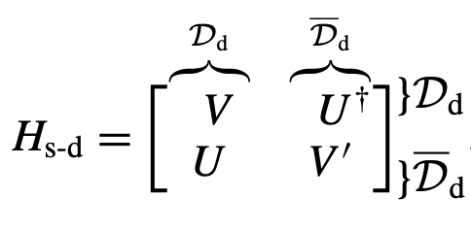

Effective Lindbladian Dynamics
OQS
Lindbladian Master Equation
Markovian
Continuum Limit Dynamics
Coupling Hamiltonian
Roy, Sthitadhi, et al. Physical Review Research 2.3 (2020): 033347.

Slide 8
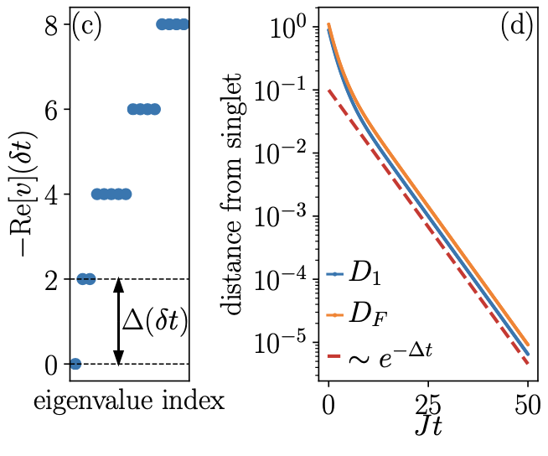
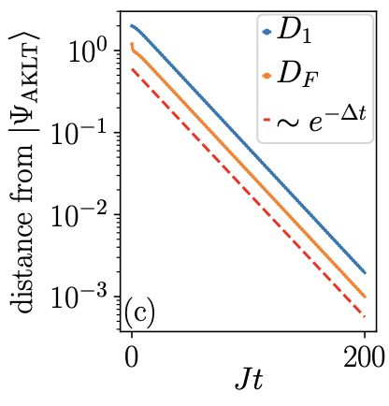
Liouvillian Gap & Rate of Approach
e.g.1 Spin-1/2 Pair
e.g.2 Spin-1 Chain
Roy, Sthitadhi, et al. Physical Review Research 2.3 (2020): 033347.

Slide 9
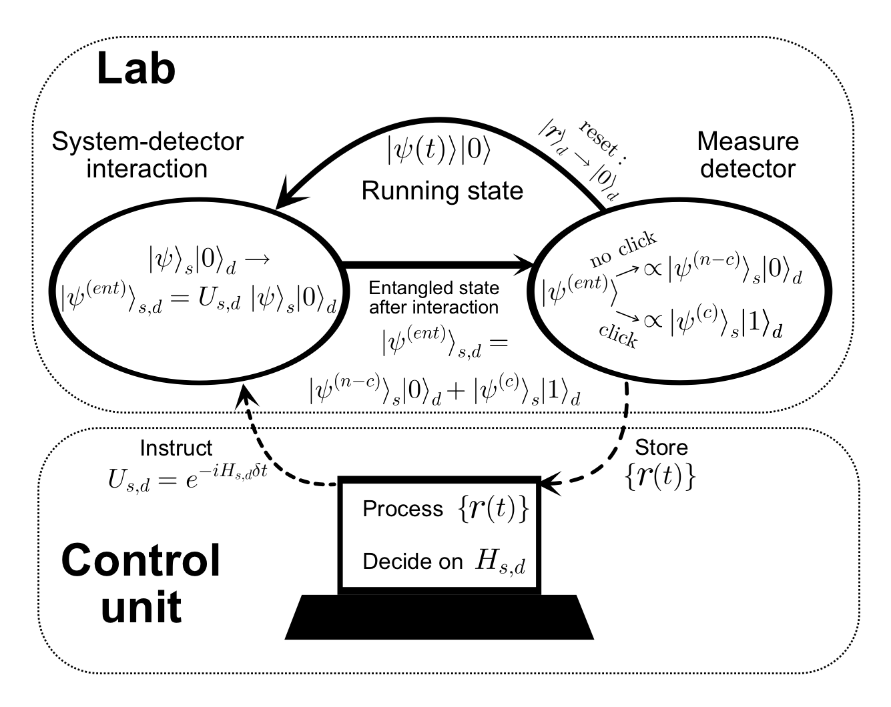
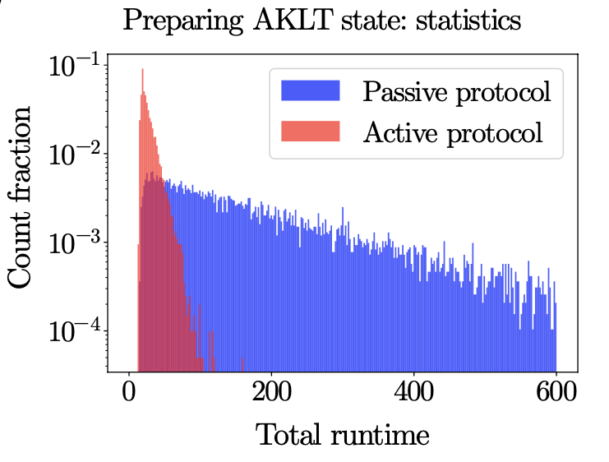
Extension: Active Quantum Steering
Active Protocol
Speedup of Steering
Herasymenko, et al. arXiv preprint arXiv:2111.09306 (2021)

Slide 10
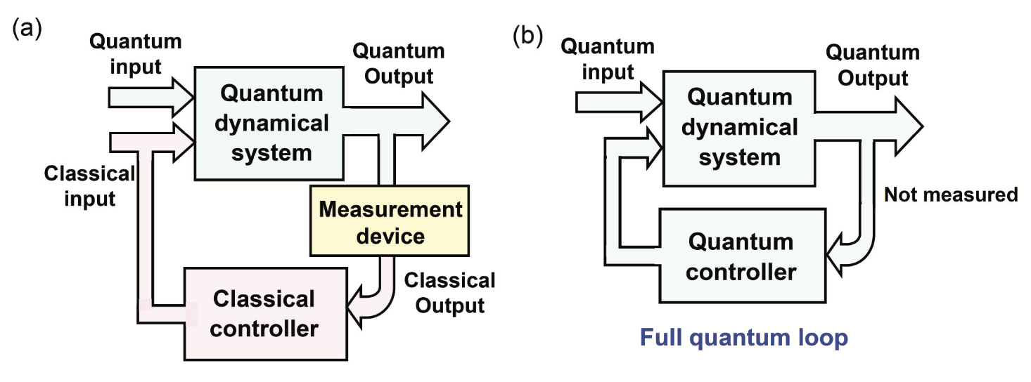
Extension: Coherent Quantum Feedback
Zhang, Jing, et al. Physics Reports 679 (2017): 1-60.

Slide 11
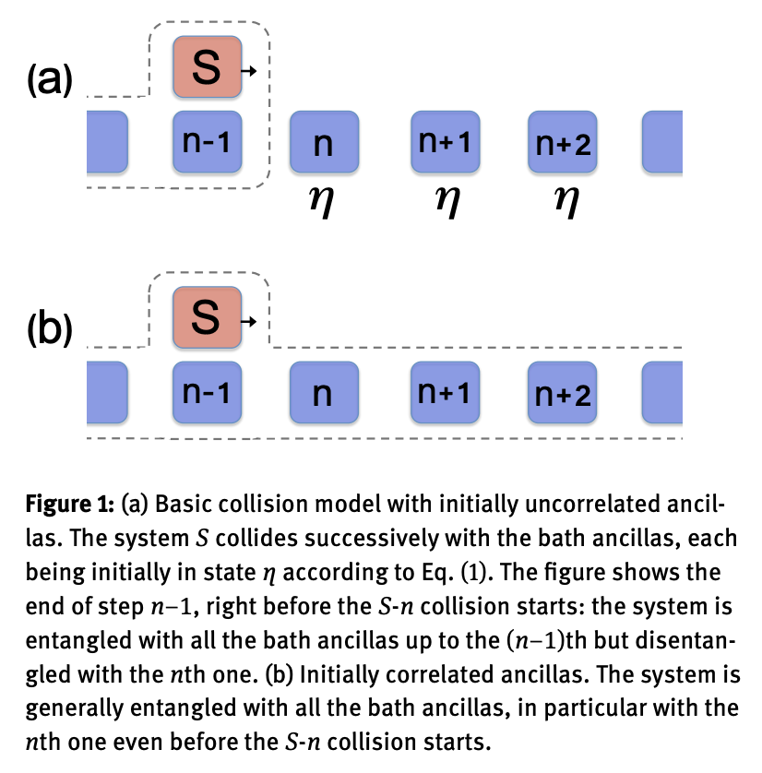
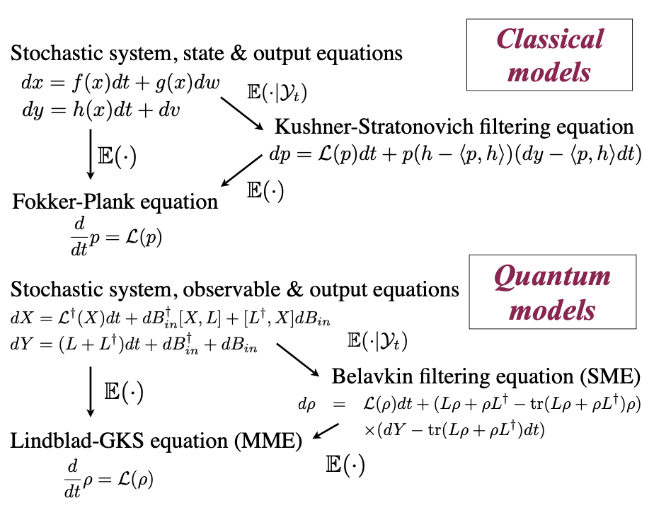
Extension: Corresponding non-Markovian Effect
Collision Model (CM)
Quantum Filtering Equation
Ciccarello, Francesco. Quantum Measurements and Quantum Metrology 4.1 (2017): 53-63.
Altafini, et al. IEEE Transactions on Automatic Control 57.8 (2012): 1898-1917.

Slide 12
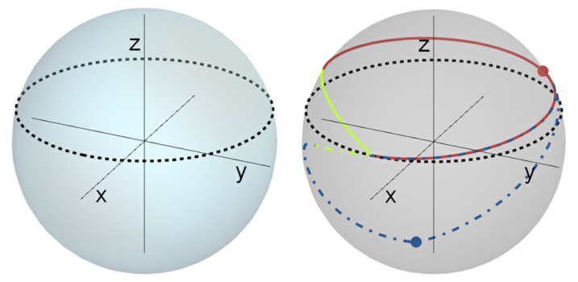
Weak-Measurement-Induced Geometric Phases
Proceedings of the National Academy of Sciences, 2020, 117(11): 5706-5713.

Slide 13
Geometric Phase
The state of a quantum system, adiabatically driven in a cycle, may acquire a measurable phase depending only on the closed trajectory in parameter space. Such geometric phases are ubiquitous and also underline the physics of robust topological phenomena such as the quantum Hall effect. Equivalently, a geometric phase may be induced through a cyclic sequence of quantum measurements.
The overall phase of a system’s quantum state is an unmeasurable quantity that can be freely assigned. However, when the system is driven slowly in a cycle, it undergoes an adiabatic evolution which may bring its final state back to the initial one; the accumulated phase then becomes gauge invariant and therefore, detectable. As noted by Berry , this is a geometric phase (GP) in the sense that it depends on features of the closed trajectory in parameter space and not on the dynamics of the process. Geometric phases are key to understanding numerous physical effects , enabling the identification of topological invariants for quantum Hall phases, topological insulators, and superconductors; defining fractional statistics anionic quasiparticles; and opening up applications to quantum information processing.

Slide 14
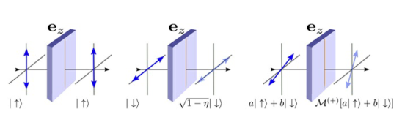
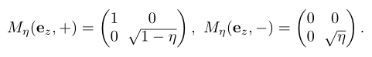
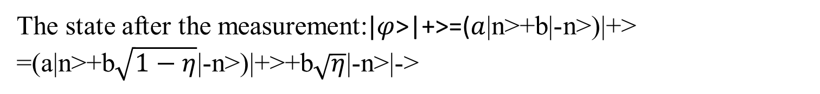
The weak measurement-induced geometric phase can be defined as
Proceedings of the National Academy of Sciences, 2020, 117(11): 5706-5713.
The state before the measurement:$|φ$>=$a$|n>+b|-n>
The state after the measurement:$|φ$>|+>=($a$|n>+b|-n>)|+>
=(a|n>+b$\sqrt{1−η}$|-n>)|+>+b$\sqrt{η}$|-n>|->

Slide 15
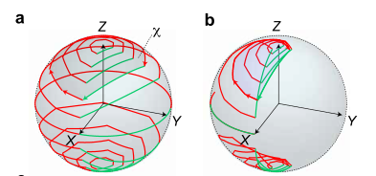
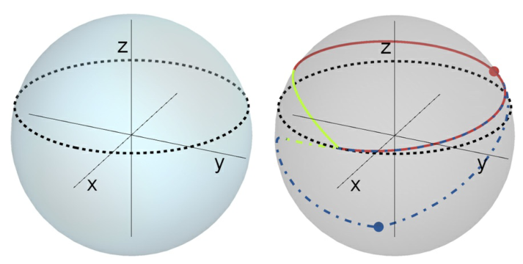
Proceedings of the National Academy of Sciences, 2020, 117(11): 5706-5713.
arXiv preprint arXiv:2102.05660, 2021.
Measurement sequences and induced quantum trajectories.

Slide 16
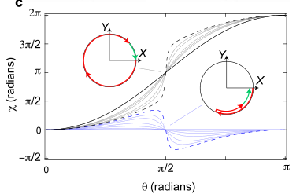
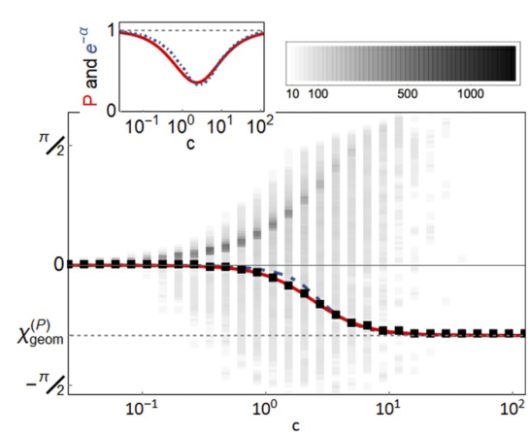
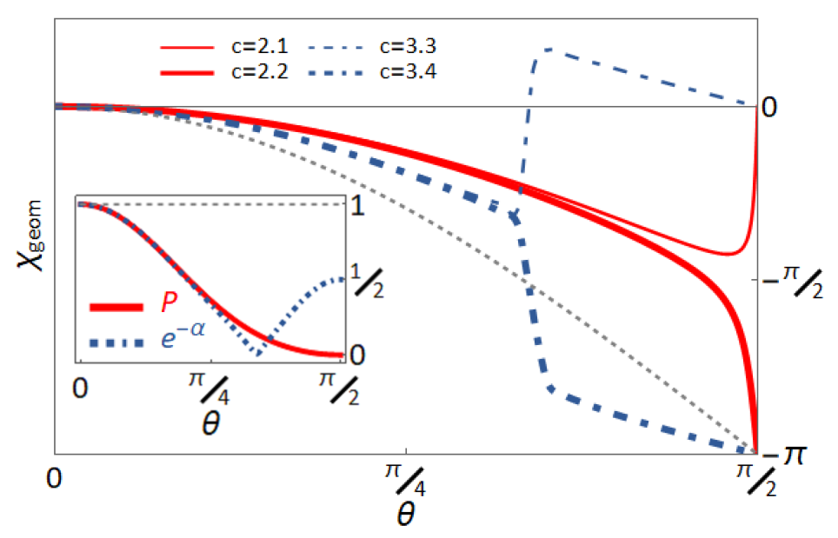
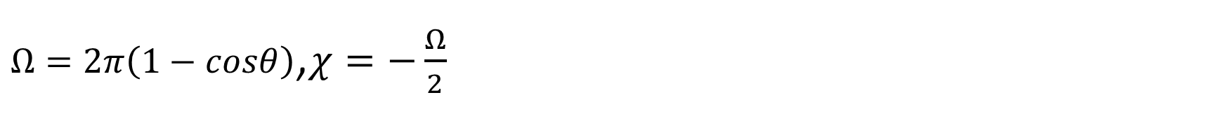
$Ω=2π\left(1−cosθ\right)$,$χ=−\frac{Ω}{2}$
arXiv preprint arXiv:2102.05660, 2021.
Proceedings of the National Academy of Sciences, 2020, 117(11): 5706-5713.

Slide 17
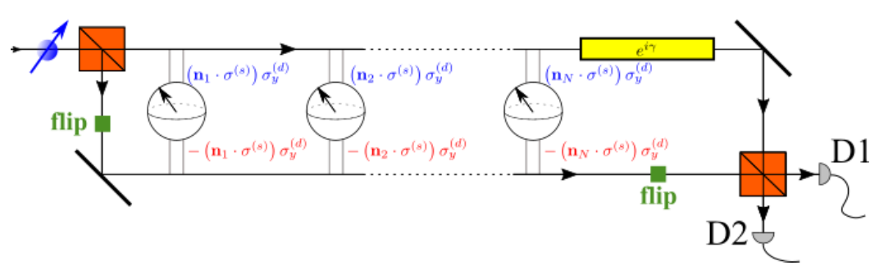
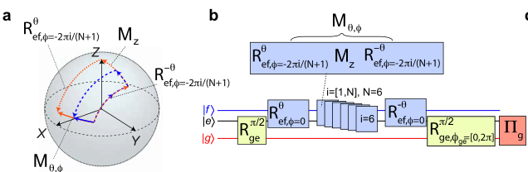
Proceedings of the National Academy of Sciences, 2020, 117(11): 5706-5713.
arXiv preprint arXiv:2102.05660, 2021.
Experimental setups for observing the averaged measurement induced GPs

Slide 18

Application：Time Crystals

Slide 19
Introduction:
时间晶体：新的非平衡态的物相；
处于基态（能量最低状态）可做周期运动的理论系统；
自发的打破时间平移对称性；
与零点能量和动态卡西米尔效应有关.
Properties：
1. 自身的状态（密度，导电率等）随周期性变化，时间平移自发对称性的破缺，表现为离散的时间平移对称性。
2. 不消耗能量，不违反热力学第二定律

Slide 20
History：
1. 2012年Frank Wilczek 最早提出时间晶体的概念——时间周期性自组织结构;
连续时间晶体(continuous time crystal) （Phys. Rev. Lett. 109, 160401 (2012)）
2. Wilczek最初的设想，被Bruno (PRL 2013)和Watanabe&Oshikawa (PRL 2015)否定掉了;
（Phys. Rev. Lett. 109, 160401 ； Phys. Rev. Lett. 114, 251603）
3. 2015年Sacha提出离散时间晶体(DTC)的概念；(Phys. Rev. A 91, 033617)
时间晶体与由外力周期性驱动的多体系统运动的量子自组织有关;
4. 2016年，加州大学柏克莱分校物理系的提出在实验室建构时间晶体的方案；
5. 2017-2018年，马里兰大学（离子阱）、哈佛（金刚石色心）和耶鲁（核磁共振系统）相继造出时间晶体;
(Phys. Rev. Lett. 117, 090402 (2016) ；Nature volume 543, pages221–225 (2017)；Physical review letters 120.18 (2018): 180603.)
6. 2020年谷歌团队使用了链状的20个超导比特实现时间晶体，完全使用数字量子模拟来实现多体局域化时间晶体的哈密顿量，即完全使用量子门电路“拼”出来想要的哈密顿量;
(PRX Quantum 2.3 (2021): 030346)

Slide 21
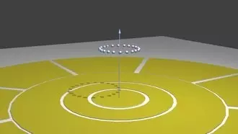
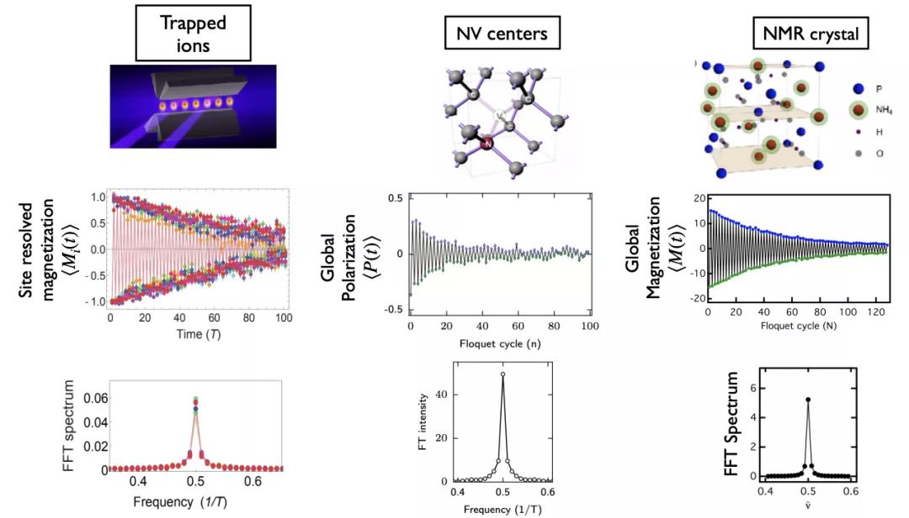
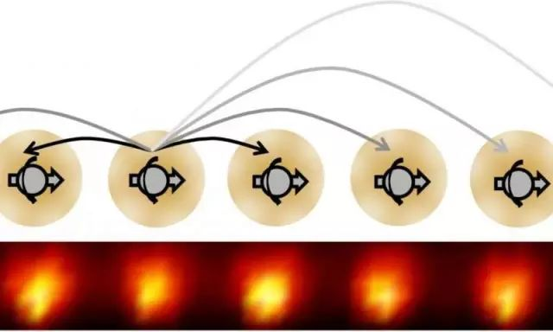
History：
马里兰（离子阱） 哈佛（金刚石色心） 耶鲁（核磁共振系统）

Slide 22
History：
Focus on：
1. periodically driven (Floquet) quantum many-body systems
2. open system etc.
基于拓扑保护的Floquet拓扑相方案
（Pan, PRR 2020）
基于超导/Majorana费米子的方案
（Gong, PRL 2018;Alicea PRL 2020）
基于非MBL的LMG模型
（Russomanno, PRB 2017）
北京量子信息科学研究院于海峰团队在超导比特系统上，通过类比量子模拟成功实现了基于YPPV模型的离散时间晶体
（arXiv:2108.00942 (2021)）
浙江大学王浩华团队实现了一类基于对称性保护拓扑态的边界时间晶体
（arXiv: 2109.05577 (2021)）
经典预热化离散时间晶体
（ PRL 127.14 (2021): 140603.）
基于元胞自动机的离散时间晶体
（arXiv:2110.00585 (2021)）

Slide 23
Further Research：
想要在理论上通过量子引导的方式，将自旋1/2的量子态或a chain of spin-1state做成时间晶体。在Gefen的报告中，他通过quantum steering距离将自旋1/2的量子态，引导到自旋单态；将a chain of spin-1state 引导成AKLT state。
11；1-1；10———00。主要的工作为学习理解quantum steering protocol的算法，之后操控上述两个 量子态。
（待修改）

Slide 24
References
[1] Roy, S., Chalker, J. T., Gornyi, I. V., & Gefen, Y. (2020). Measurement-induced steering of quantum systems. Physical Review Research, 2(3), 033347.
[2] Herasymenko, Y., Gornyi, I., & Gefen, Y. (2021). Measurement-driven navigation in many-body Hilbert space: Active-decision steering. arXiv preprint arXiv:2111.09306.
[3] Zhang, J., Liu, Y. X., Wu, R. B., Jacobs, K., & Nori, F. (2017). Quantum feedback: theory, experiments, and applications. Physics Reports, 679, 1-60.
[4] Altafini, C., & Ticozzi, F. (2012). Modeling and control of quantum systems: an introduction. IEEE Transactions on Automatic Control, 57(8), 1898-1917.
[5] Belavkin, V. P. (1992). Quantum stochastic calculus and quantum nonlinear filtering. Journal of Multivariate analysis, 42(2), 171-201.
[6] Ciccarello, F. (2017). Collision models in quantum optics. Quantum Measurements and Quantum Metrology, 4(1), 53-63.
[7] Tilloy, A. (2017). Time-local unraveling of non-Markovian stochastic Schrödinger equations. Quantum, 1, 29.
[8] Gebhart V, Snizhko K, Wellens T, et al. Topological transition in measurement-induced geometric phases[J]. Proceedings of the National Academy of Sciences, 2020, 117(11): 5706-5713.
[9] Wang Y, Snizhko K, Romito A, et al. Observing a topological transition in weak-measurement-induced geometric phases[J]. arXiv preprint arXiv:2102.05660, 2021.

